Slide 1
Facilities Report
Woodland Public Schools
April 2025

Slide 2
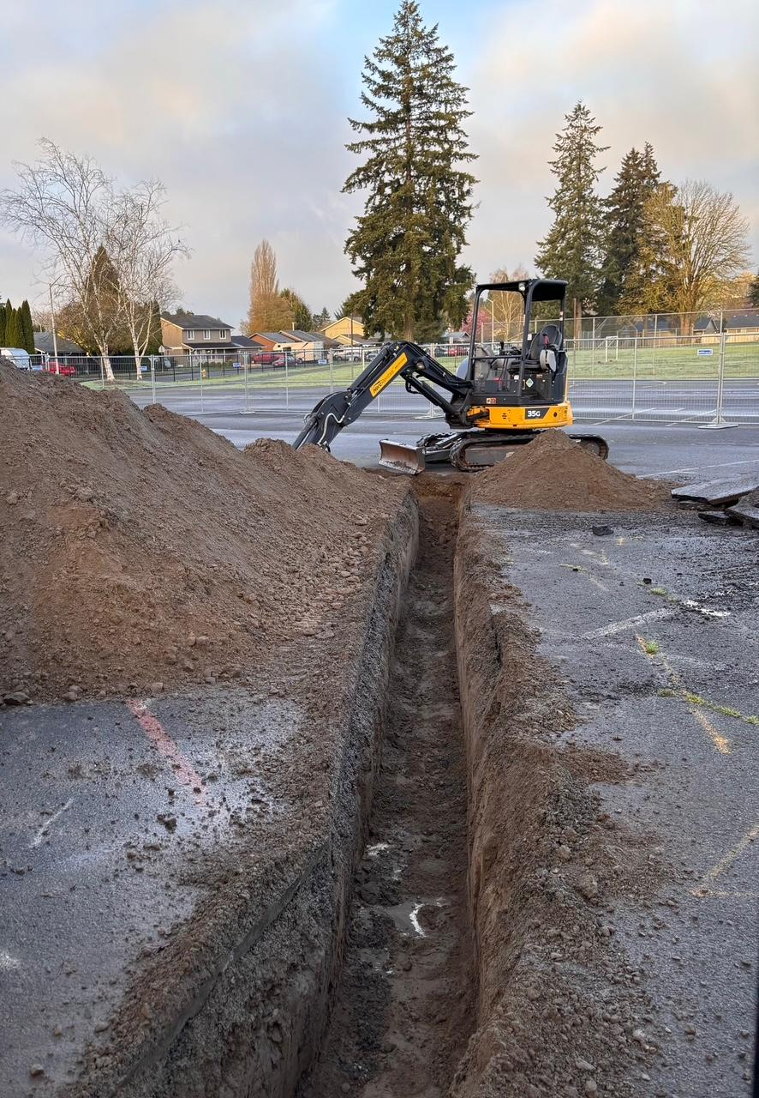
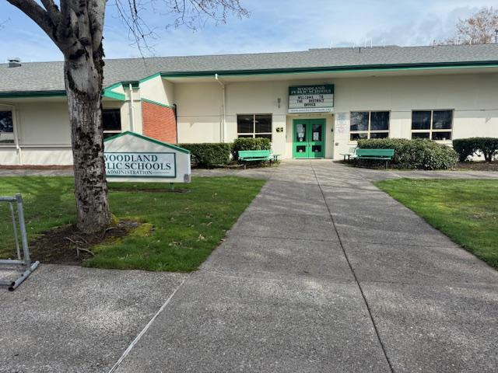
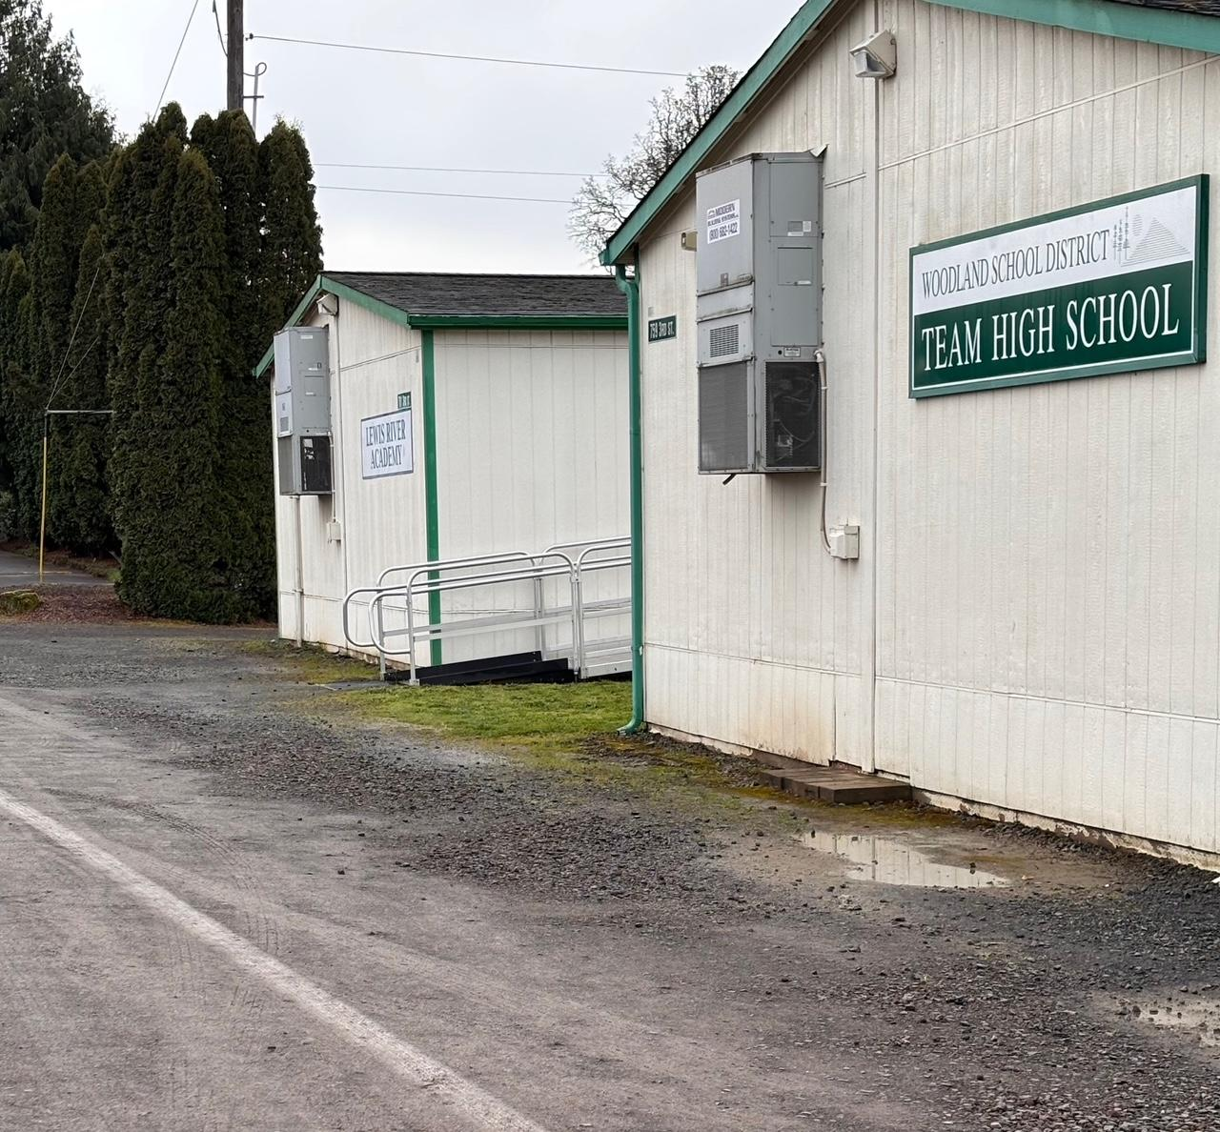
Work Currently In Progress: Projects
Study and Survey Project
New Portable at NFES Project
ADA Compliance Project
Section
12
D1 grant funding in place to cover cost
LSW Architects is completing the work
Site work completed
Portable to be placed by April 24th, 2025.
ADA compliant walkway being completed between WMS and TEAM High portable
District office
Ground work being completed for new portable at NFES
Current access to TEAM portable

Slide 3
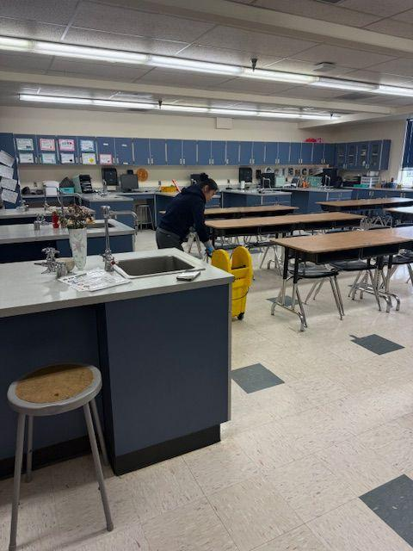
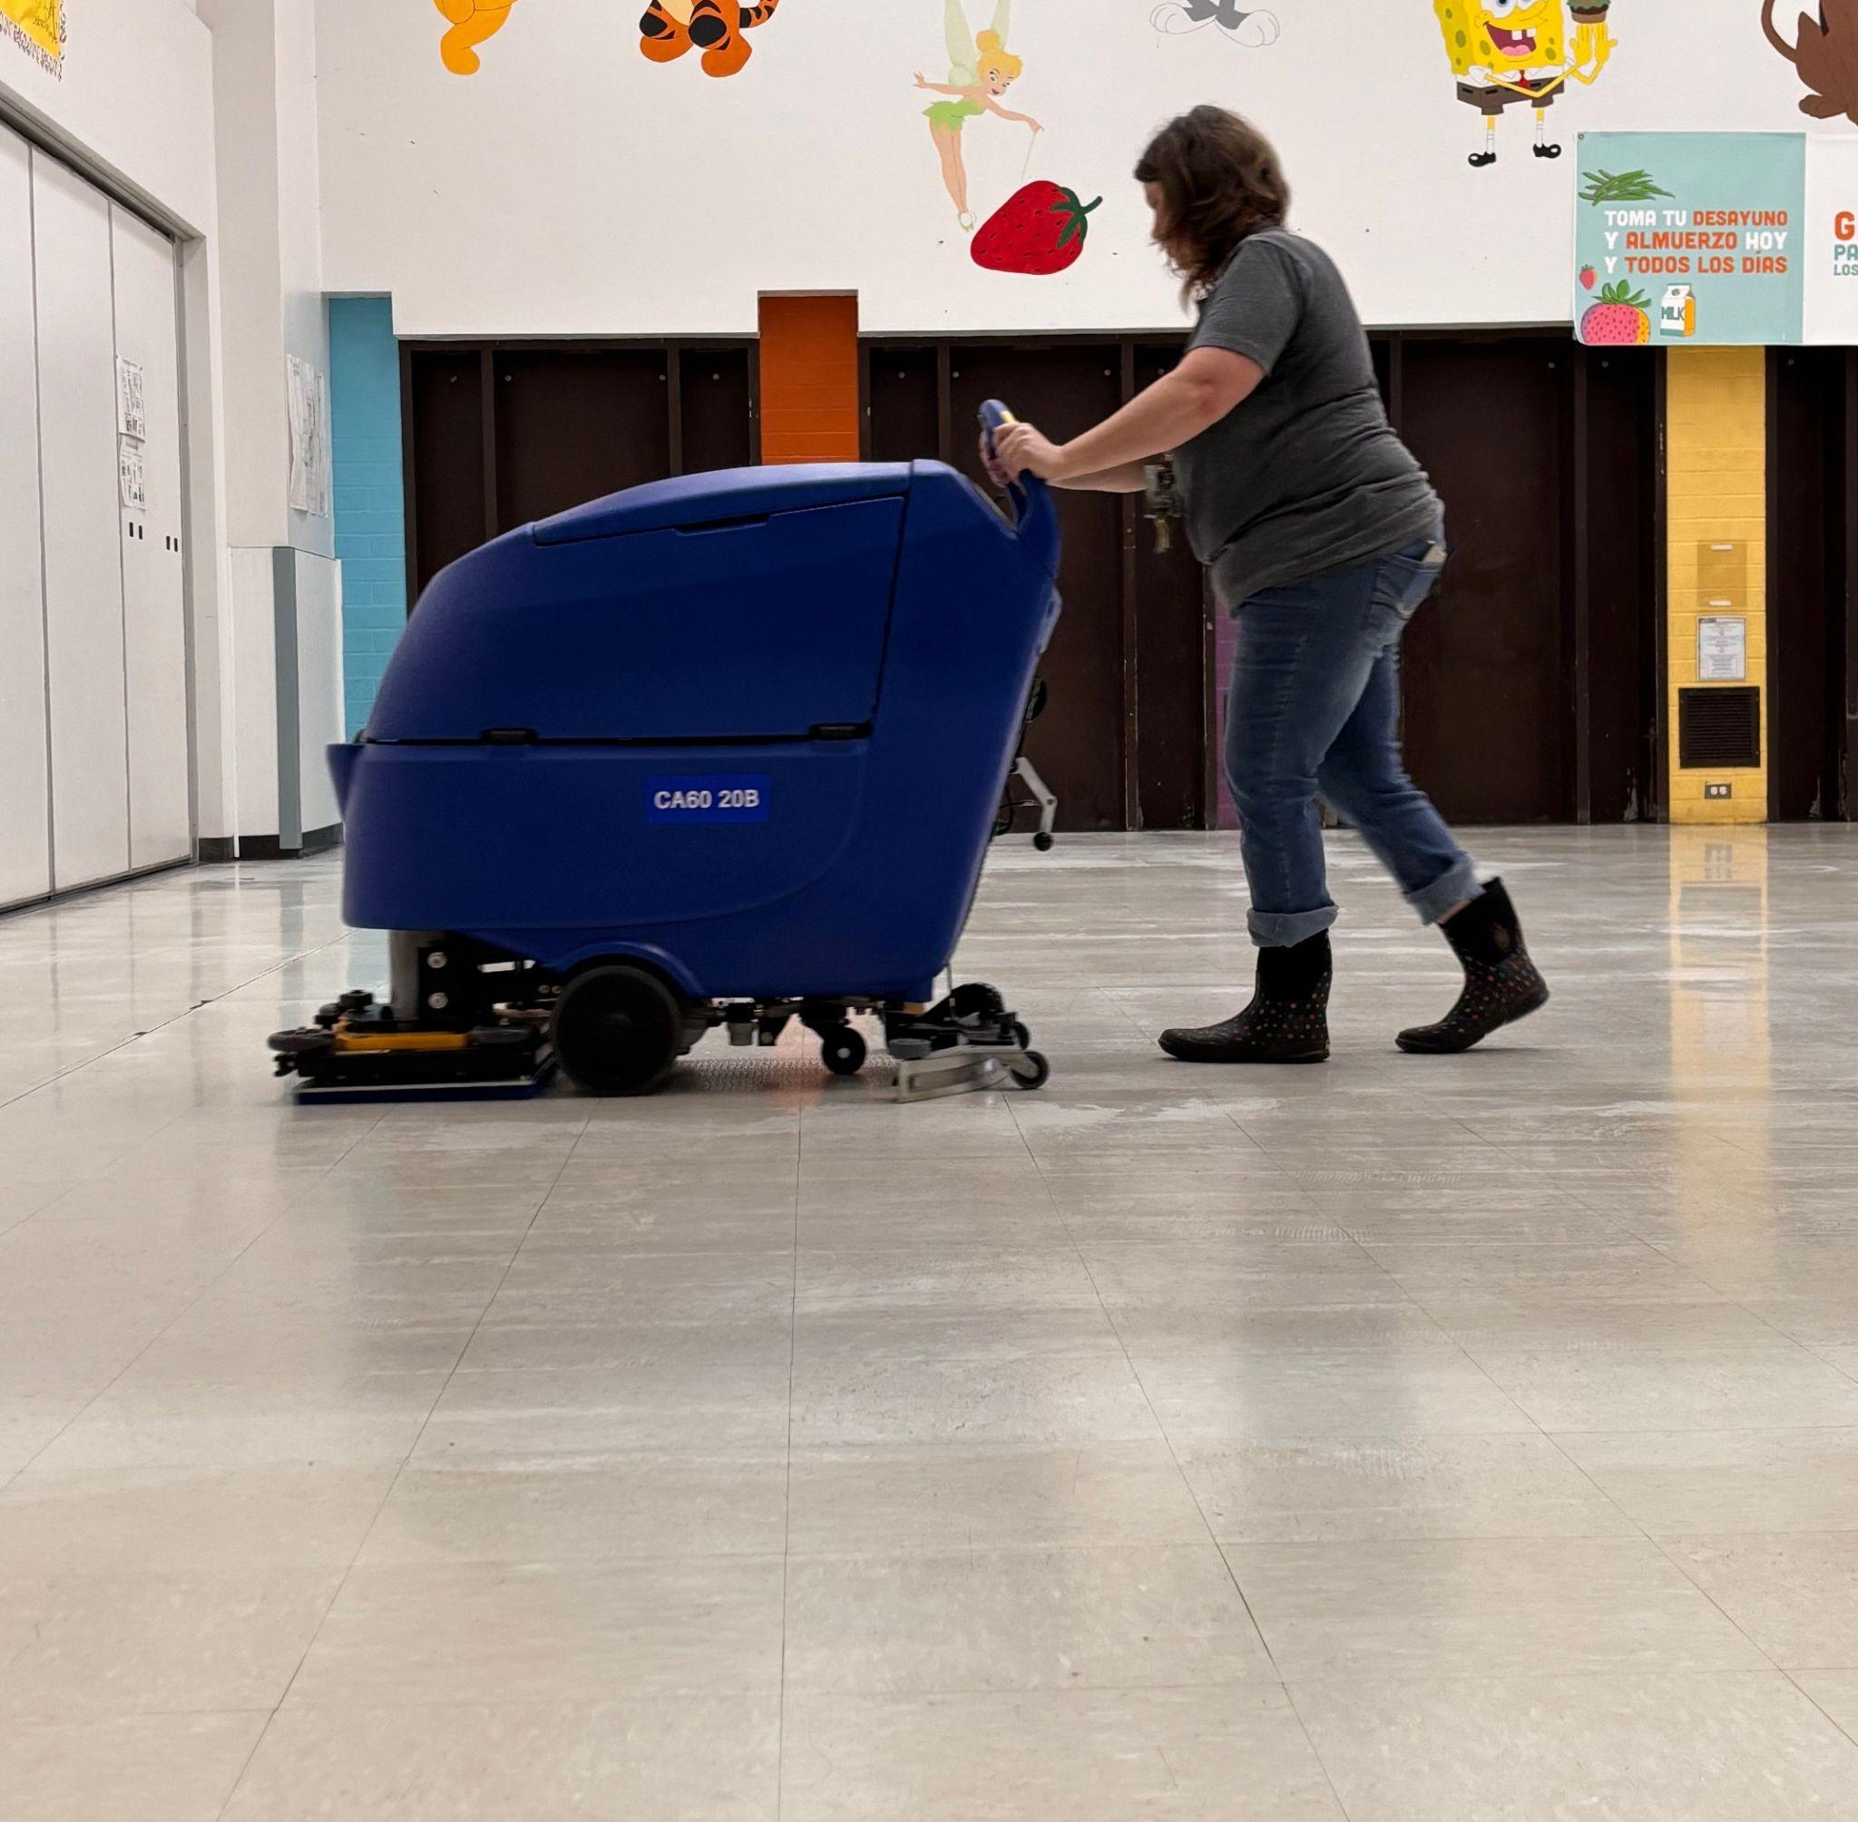
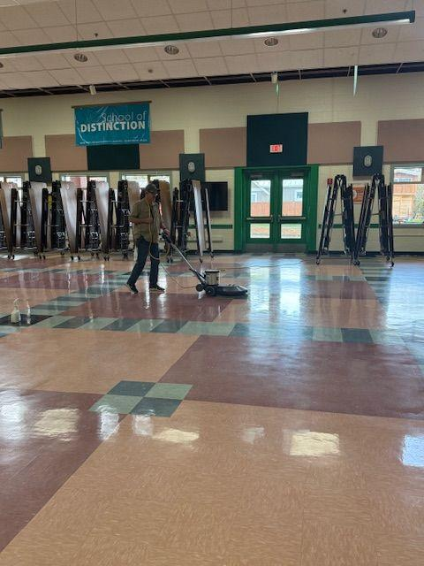
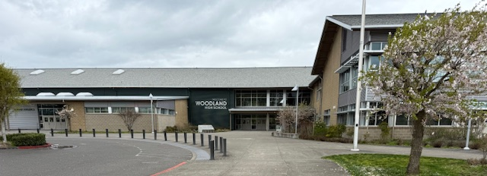
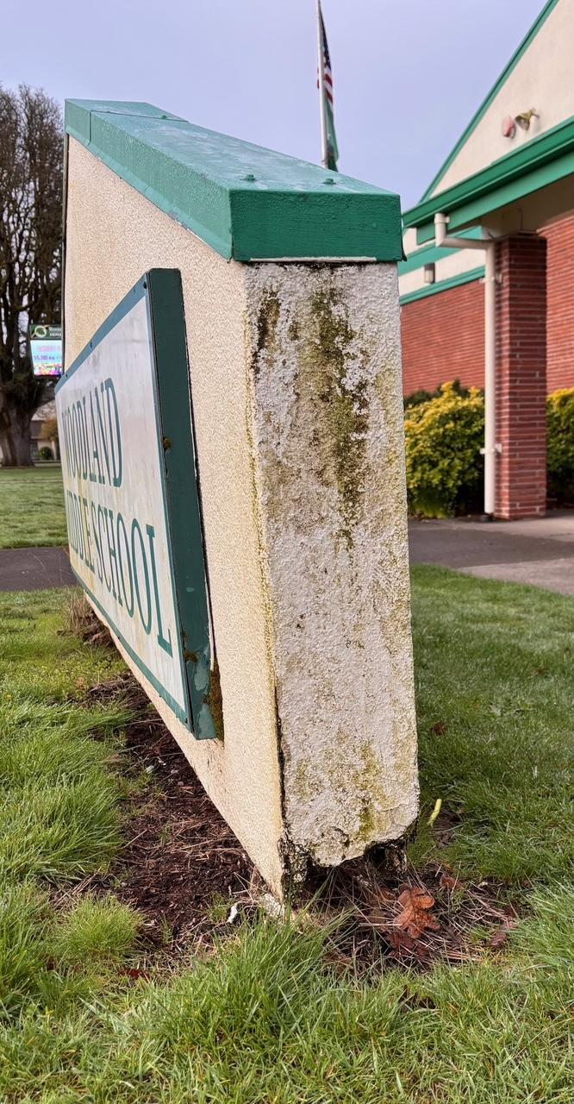
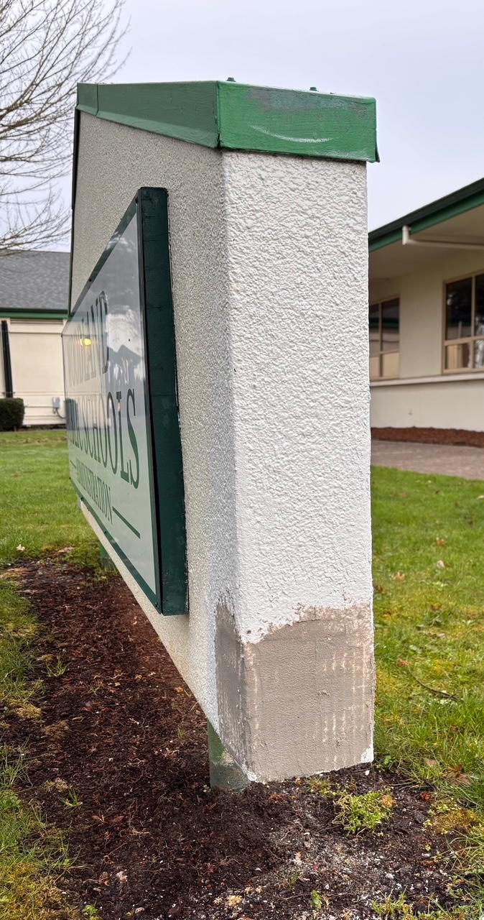
Work Currently In Progress By Facilities Staff
Custodial
Grounds
Maintenance
Assigned detailed cleaning schedules for spring break including:
Deep cleaning restrooms
Polishing floors
All custodians are now CPR/First Aid/AED certified
Sports fields are prepped and fertilized for Spring Sports
Weed and debris removal
Adding bark to outdoor spaces
Both Grounds personnel are now CPR/First Aid/AED certified
Curb appeal projects to enhance exterior spaces:
Pressure washing
Cleaning and repairing signage throughout the district
Maintenance personnel is now CPR/First Aid/AED certified
Before and After: District Sign

Slide 4
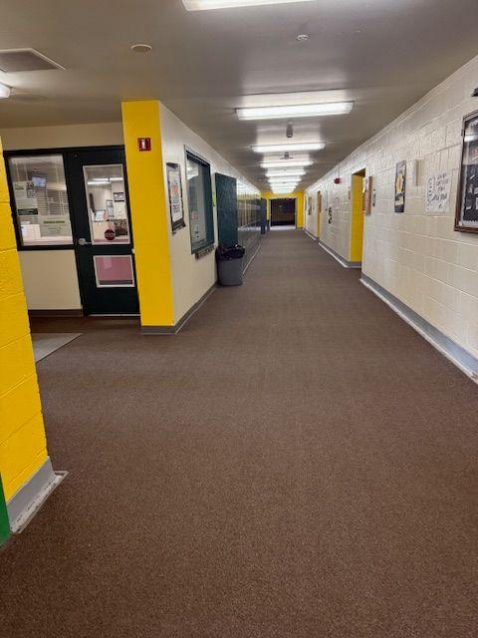
Planned Upcoming Work: Building A List of Summer Projects
Construction of dugout shelters for WHS JV ball field
Replacement of locker room stalls at WMS
Providing ADA access to the WMS stadium
Possible installation of GaGa pits
Painting the “Yellow Hall” at WMS a more modern yellow
High priority carpet replacements throughout school district
Sweeping and re-striping of all parking lots
Will need to hire temporary summer help
Pressure washing all walkways and monument signs
Will need to hire temporary summer help
Removal of weeds from flower beds and application of Pre-Emergent
Will need to hire temporary summer help
Resurfacing and replacement of old compacted bark chips at all playgrounds

Slide 5
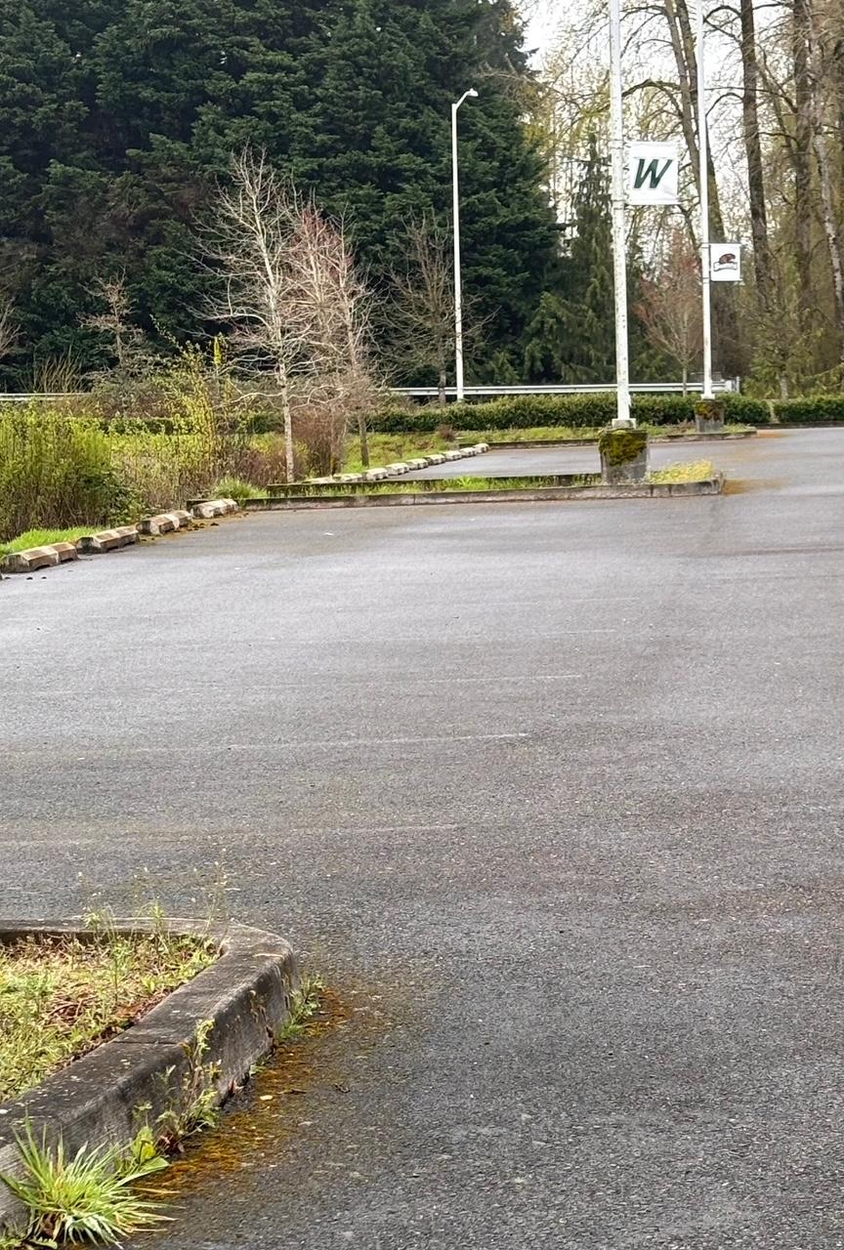
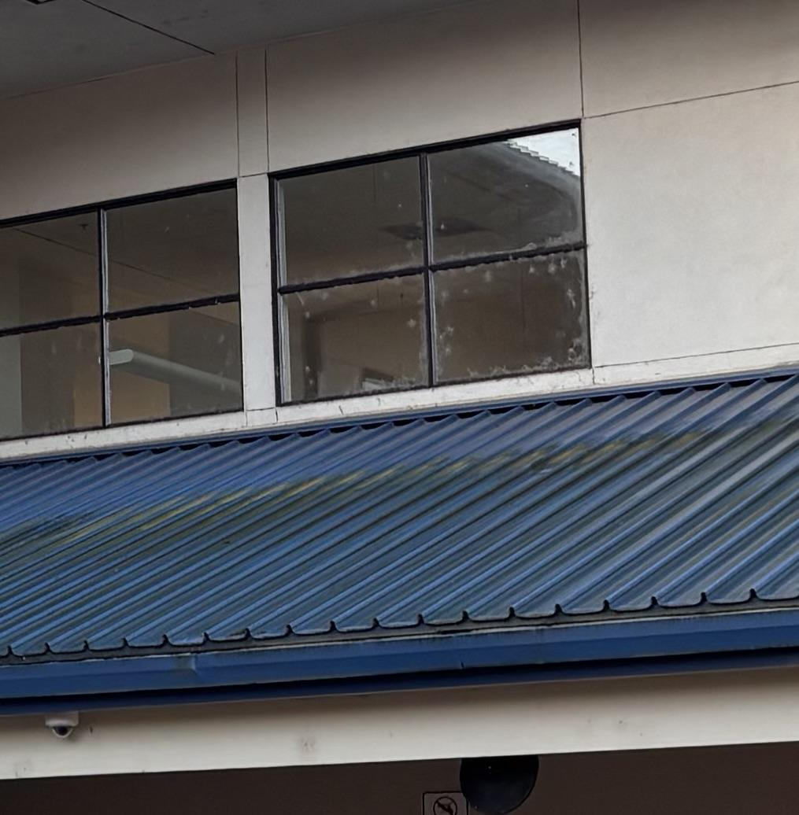
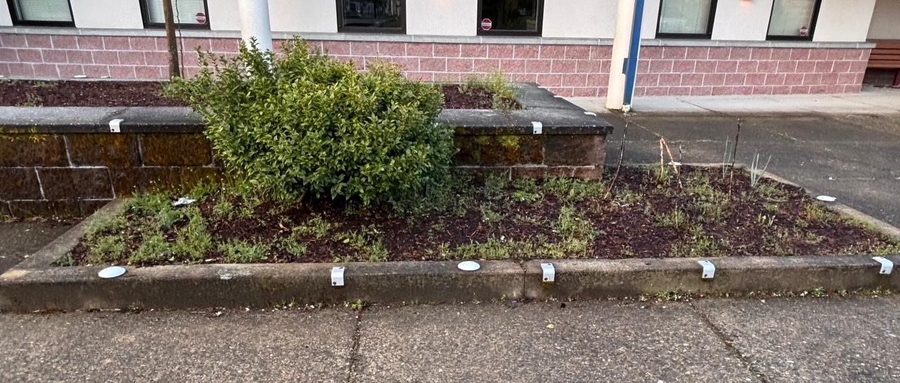
Annual Work
Annual maintenance work made possible with the addition of staff lost due to the previous double levy failures.
Refinish floors district-wide
Painting of the exteriors of two portables per year
Re-striping of all parking lots
Weeding, edging, and resurfacing of flower beds and lawn areas
Re-graveling of parking lots at NFES & Yale ES
Replacement of HVAC filters 3 times per year
Upper floor exterior window cleaning at WHS and NFES
Locker cleaning & combo changes
Upper windows at NFES
Faded parking stripes at WHS
Flower beds needing attention at NFES

Slide 6
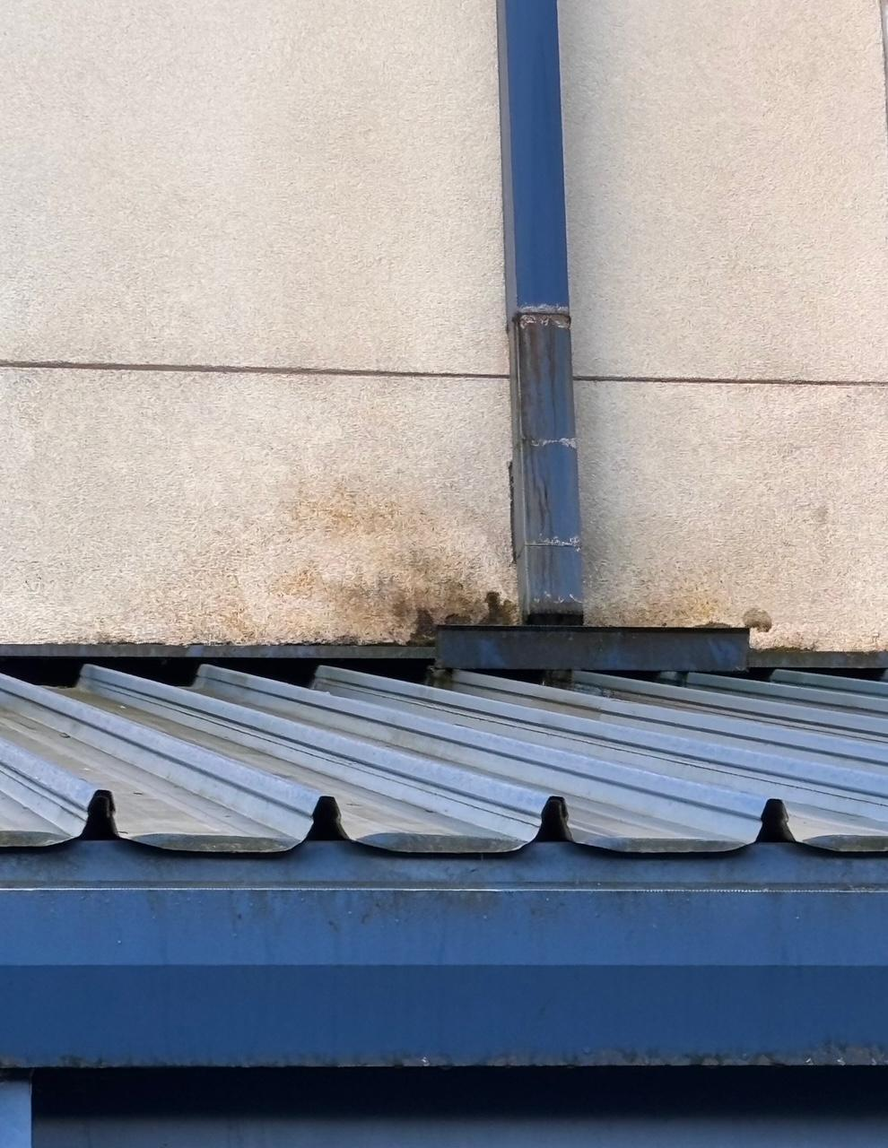
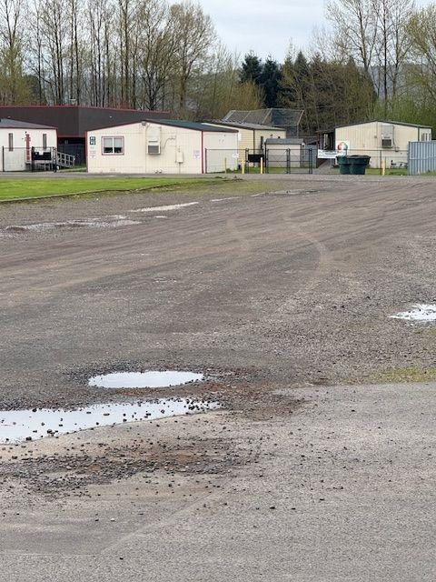
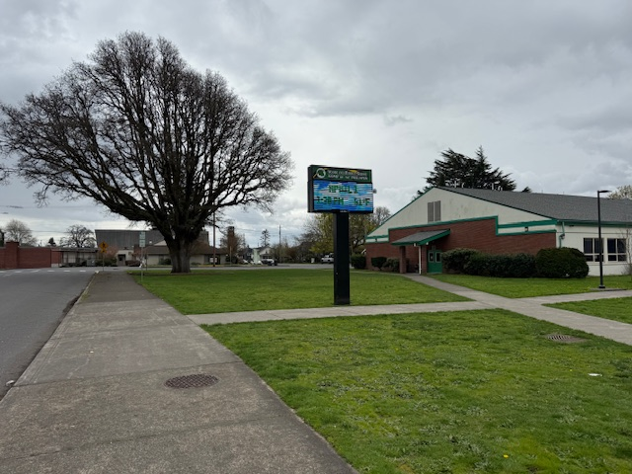
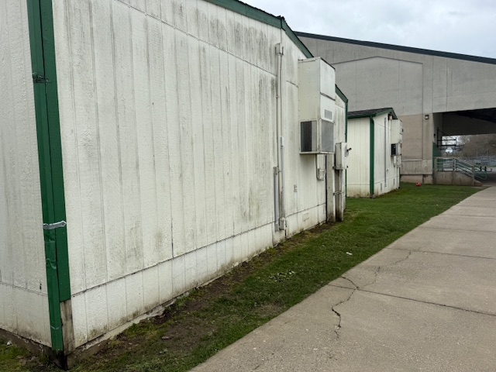
Annual Work
Roof and gutter cleaning
Gutter repairs
Aerial lift training
Cleaning of accessory facilities i.e. ticket booths, press boxes, storage areas
Cleaning of monument signs, reader boards, & scoreboards
Playground touch-ups and resurfacing
Testing of backup energy systems and emergency lighting
Touch up painting throughout school district
Gutters at NFES needing repairs
ReaReader board at WMS
Re-graveling needed between WMS and CES
Portables needing fresh coat of paint at WMS

Slide 7
Thank You For Your Time And Consideration
Facilities Department

